Slide 1




Problem statement :-
“create an ai-powered stock market information platform that offers real-time data, company comparisons , predictions using technical indicators, and access to relevant courses for investor education.’’
By Team:
The Team

Slide 2

3. Innovative Predictive aplication :-
the application consists mainly of 8 tabs that are given as follows
01
03
02
Stocks
HomeHome
Company
04
05
06
Predict
Dashboard
Course
07
08
Indicators
Bot

Slide 3
The home lab in our application provides login and signup authentication crediantals inorder to provide secure to the both the company’s and data and users access. We do provide the overall information of some companies like Reliance,Tata,Microsoft,Apple which acts as a central hub where users can go through the company ‘s website on clicking upon the Buttom(Invest now).
we have taken the real time data from yahoo finance that provide access to fetch real-time data such as stock prices, company details, and financial metrics.
Using Streamlit to fetch data from Yahoo Finance and present it in a user-friendly interface is a practical and efficient approach. Streamlit simplifies the process of creating interactive data-driven applications, making it easier for you to build a "Home" tab that displays information sourced from Yahoo Finance.
We also providing the FAQ’s that might be helpful for the user for better clarification of their doubts regarding the investments and some of the terminologies that are often used in stock market.
1.Home :-

Slide 4
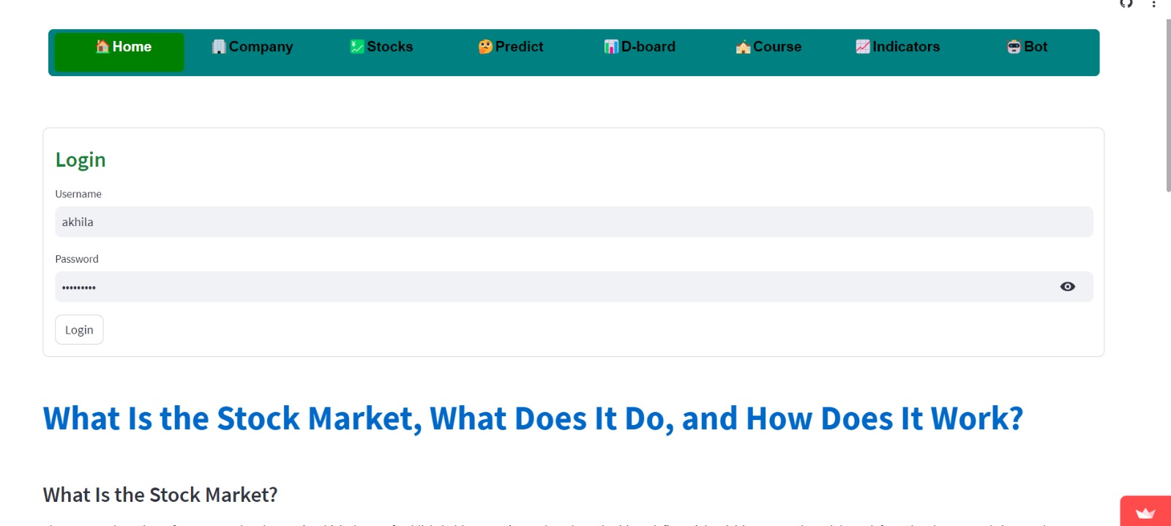
Login

Slide 5
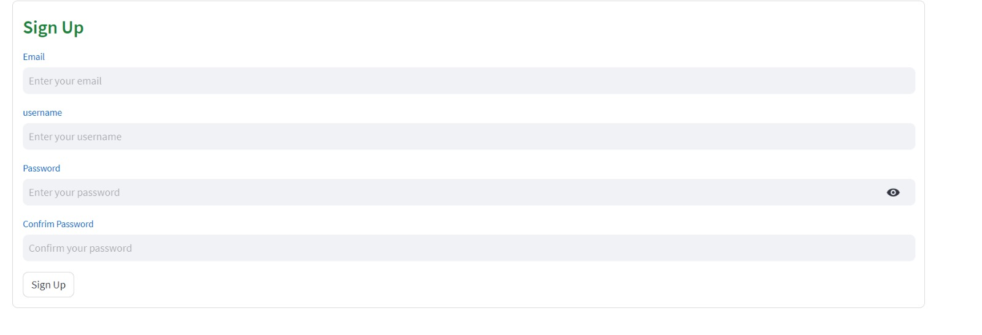
Signup
Login

Slide 6
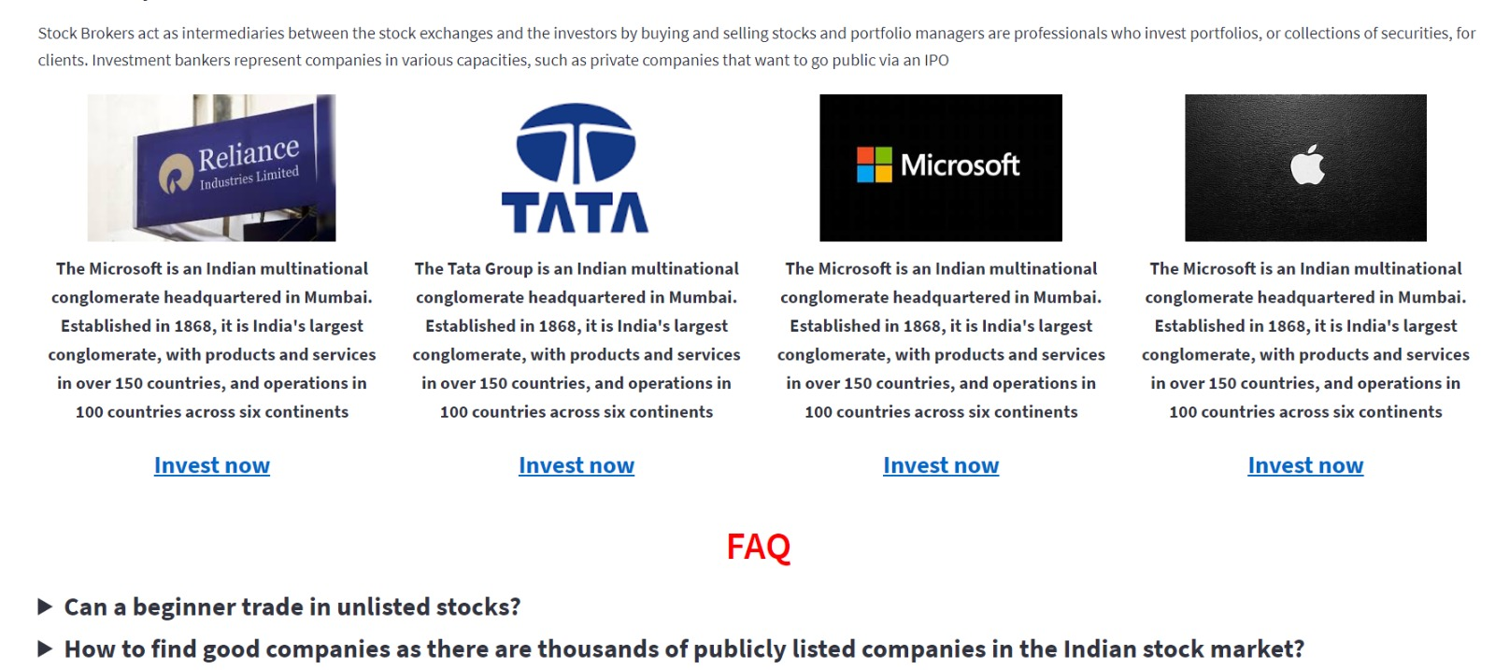
Home
Signup
Login

Slide 7
In this ,one get to know about the specific company’s details and also the companies transcations,trades in addition to it,the user can also know the average dividend percentage and split ratio that makes investors or traders to make informed decisions and implementing their strategies , the users can also know more about the insights of the company i.e., company’s shareholders and news for any updated information regarding the company’s economy or status.This information can influence their investment decisions and help them understand the factors impacting the company's stock .
the Streamlit app features a sidebar for users to input a company symbol(Ticker) or name of an company. The app then fetches and displays company information, news articles, actions and major holders' details using the appropriate data fetching methods and HTML parsing. and the whole information is fetched from yahoo finance.
2.Company :-

Slide 8
In “stocks” tab one can get to know about the company stock trends,and its price change, moving average and also intraday range, and this intraday is useful for traders for better strategies.
Trends of an company allows users to identify patterns, trends, and fluctuations that have occurred in the market.We provide a clear assessment of the change in stock prices. This includes calculating the difference between the current stock price and the initial price, which gives users an immediate understanding of how the company's stock has performed over the chosen time frame.
The moving average smooths out the day-to-day price variations, providing a clear trend direction and assisting users in identifying potential status of the company.
the Streamlit app features a sidebar where users can input a company. The app then fetches historical stock price data from Yahoo Finance using yfinance, calculates the moving average and intraday range, and displays the information along with relevant visualizations using plotly for dynamic view.
3. Stocks :-

Slide 9
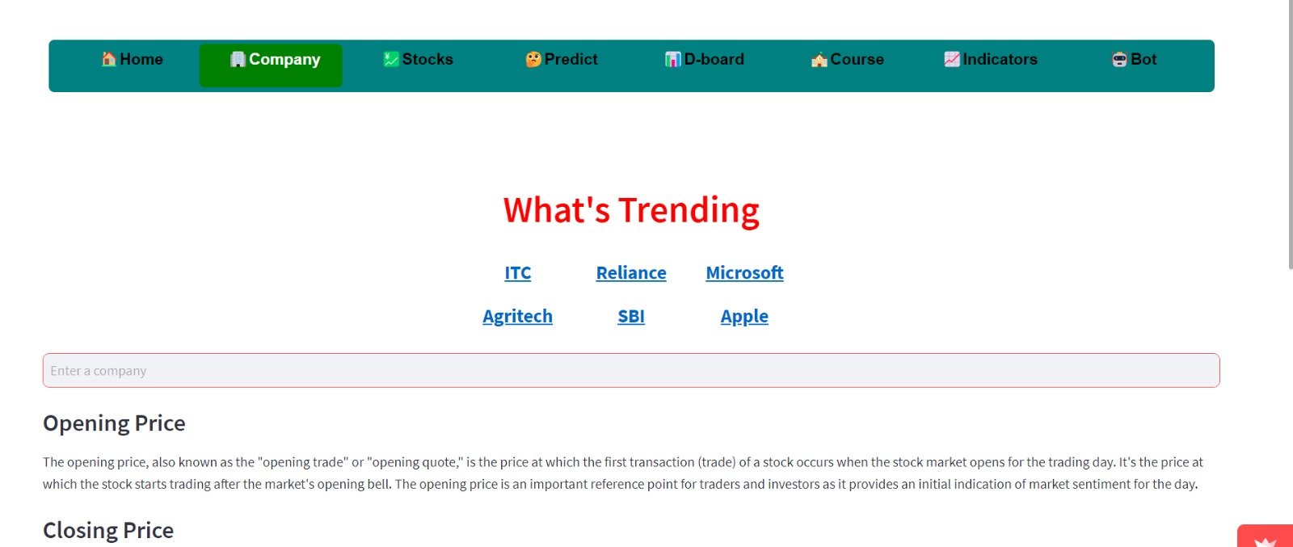
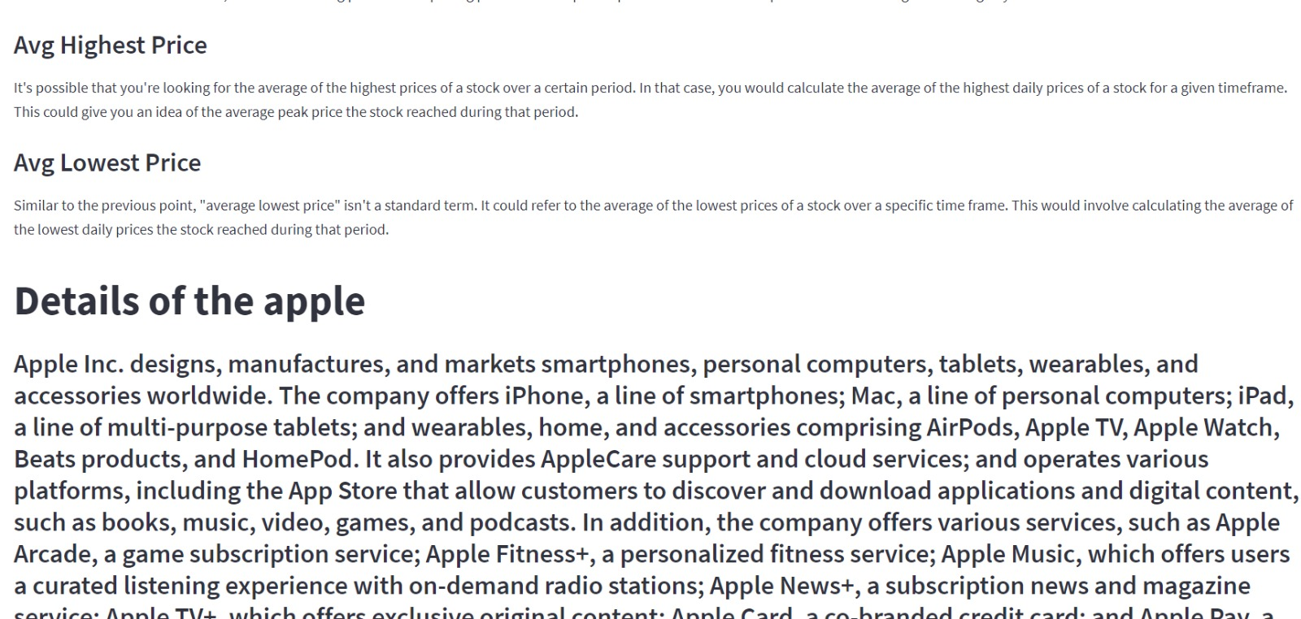
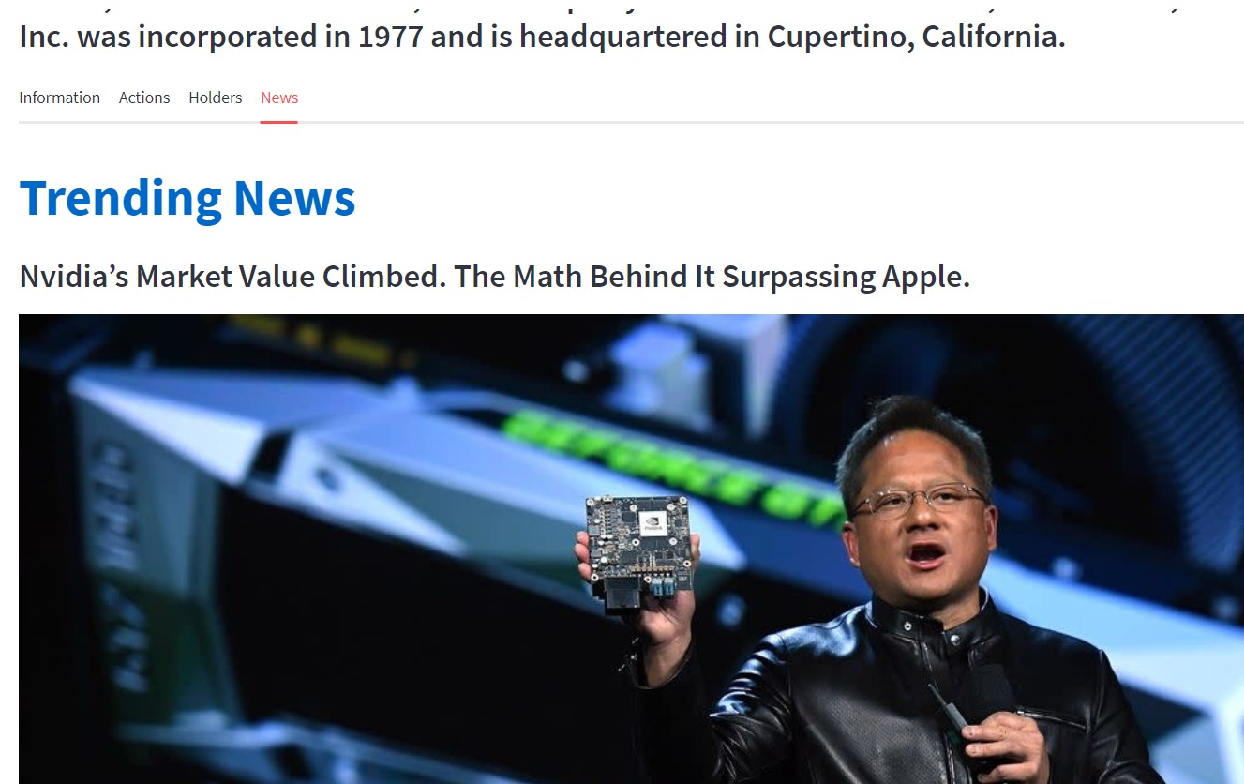
Company

Slide 10
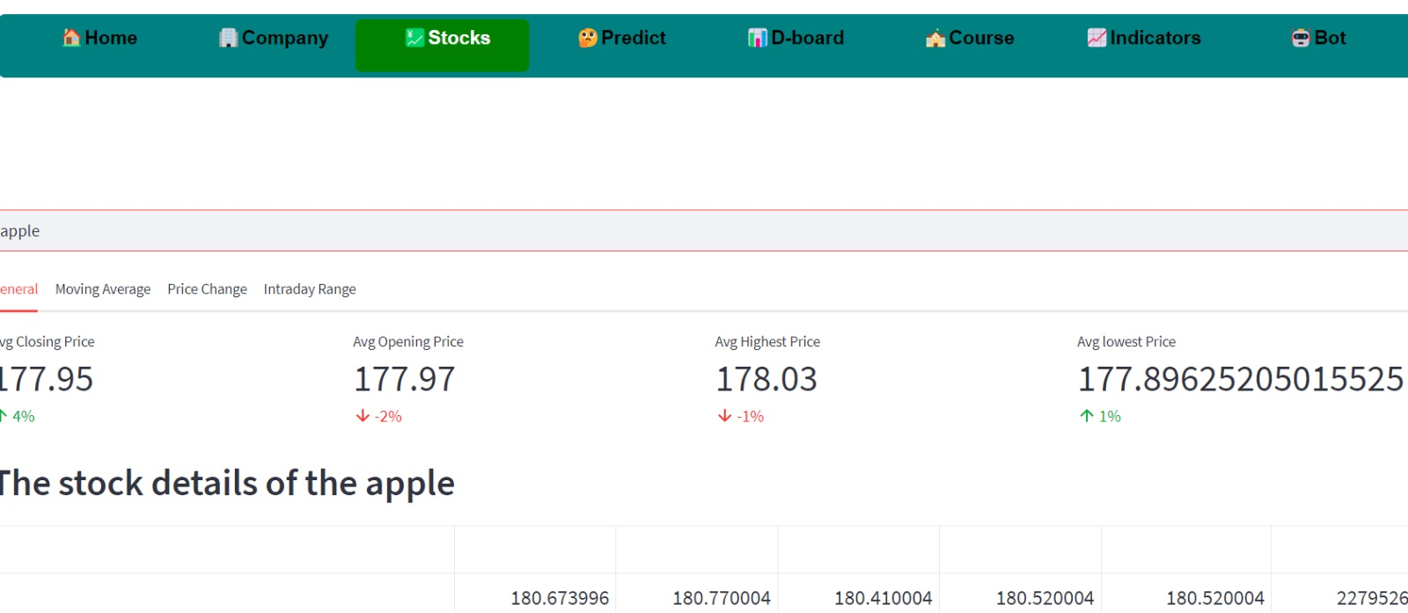
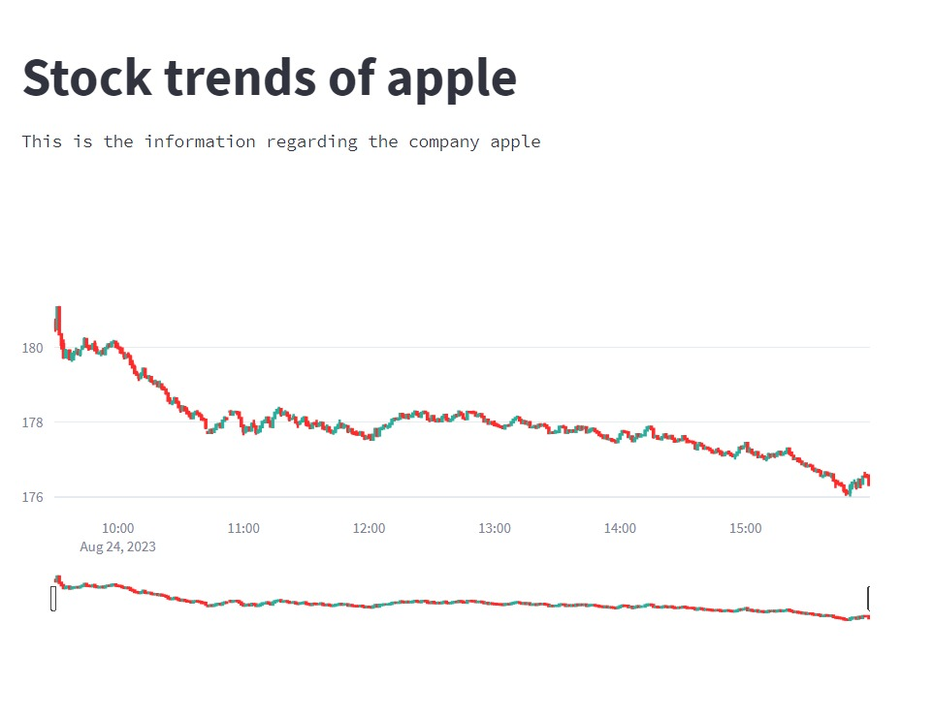
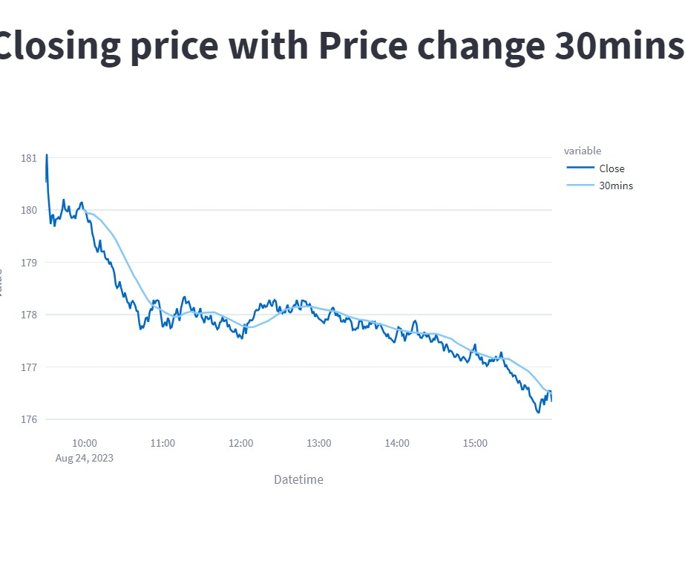
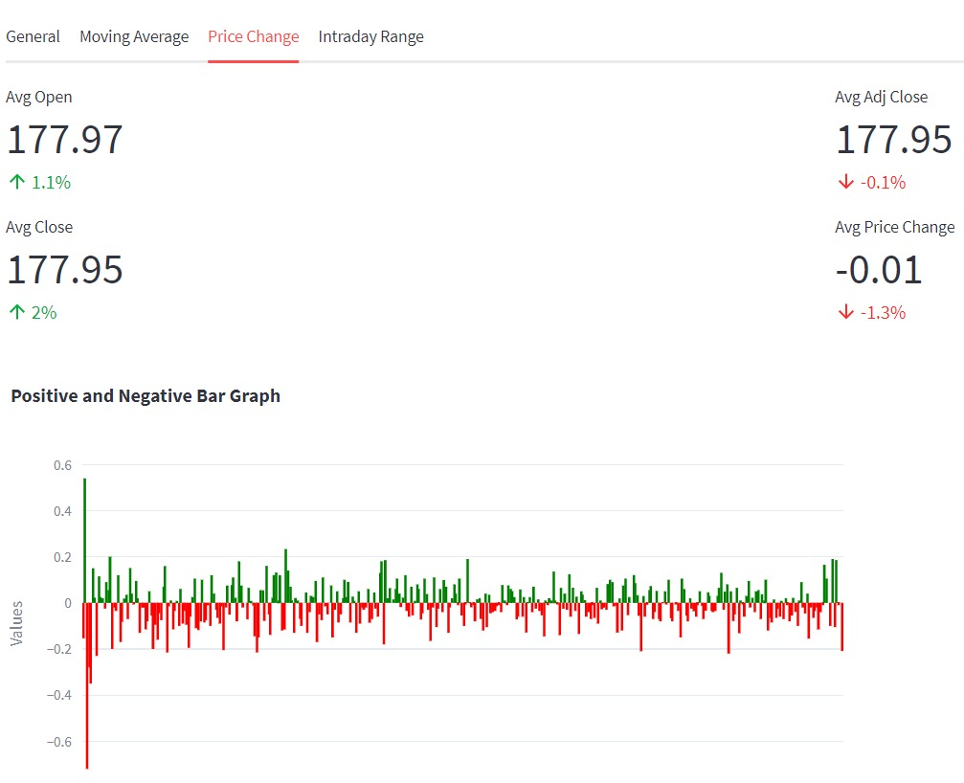
Stocks
Company

Slide 11
In our dashboard, we present a comprehensive snapshot of a company's stock performance by highlighting the changes in its open and closing prices over a user-selected period. This feature offers a concise yet insightful overview of how the company's stock has evolved during the chosen timeframe.
we also presented how its indicators are been changing over the period selected by the user.
our integration of Yahoo Finance data and Plotly visualization enhances the user experience as it makes fundamental analysing of company’s stocks so that he/she capable of identifying best stocks.
This dashboard benefits companies by offering insights into their stock's historical performance, It enhances their understanding of market trends and investor sentiment, helping in strategic decision-making, investor communication, and overall market positioning.
5.Dashboard :-

Slide 12
The courses cover essential aspects of the stock market, introducing beginners to its terminologies, concepts,and its fundamental and technical analysis of the stocks and also realted information of our website.
These videos helps users for better trading and investment in the stock market world that eventually benefits the company’s economy and users finanancial status.
It is an user friendly application for an begineer who wants to build his career in stock market field, where technical and fundamental analysing of charts and patterns helps users to identify the market rate.
6.Course :-

Slide 13
4.Predict :-
The "Predict" tab allows users to input historical stock data of their chosen company and specify the number of future days for prediction. Utilizing this input, the tab employs predictive models to estimate future closing prices,offering users insights into potential trends based on their provided historical data.
The predictive models are been done using LSTM,GRU,RNN where LSTMs, advanced neural networks, excel at understanding sequences like stock price data, capturing intricate patterns over time. Used in stock prediction, LSTMs analyze historical trends to forecast future prices, aiding investors in decision-making.
GRU captures trends, volatility, and potential trading signals, despite having a simpler architecture compared to some other models.

Slide 14
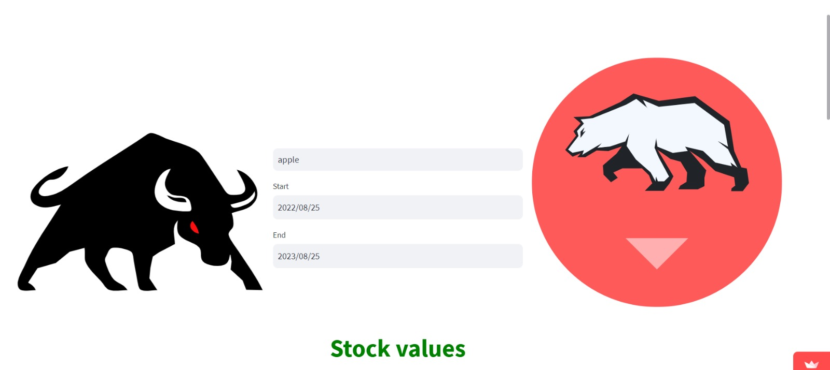
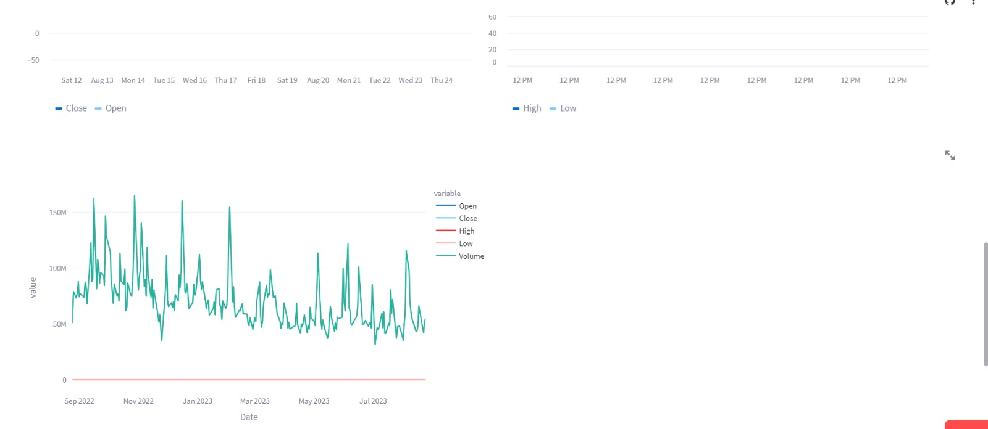
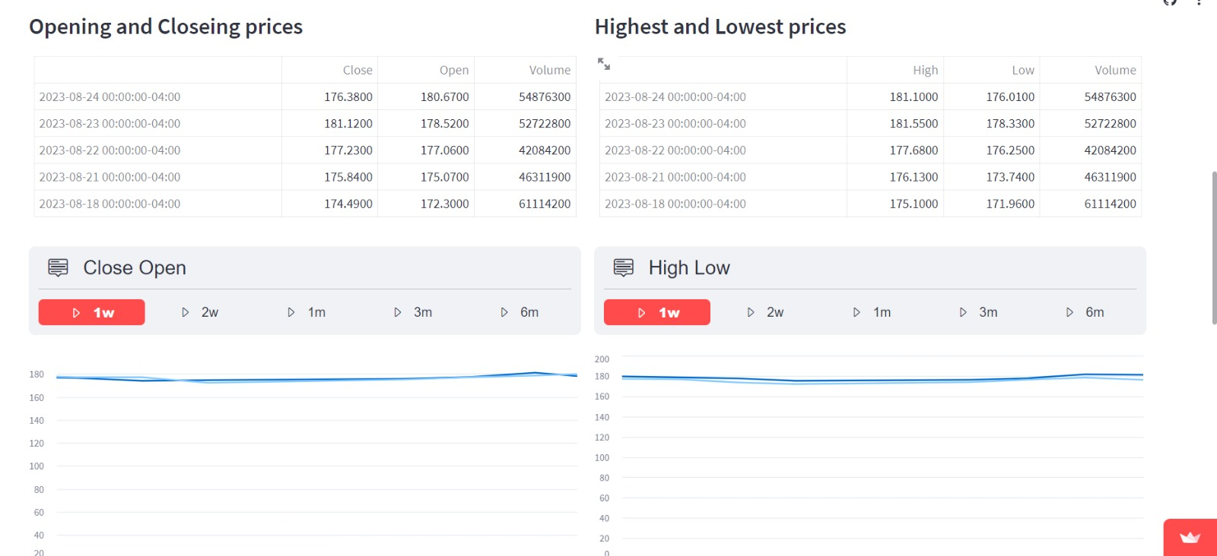
Dashboard

Slide 15
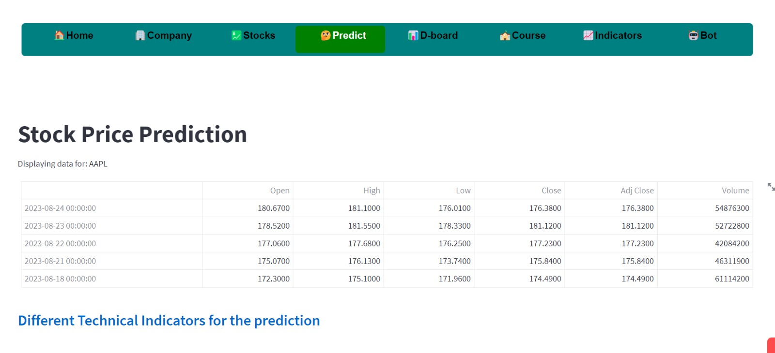
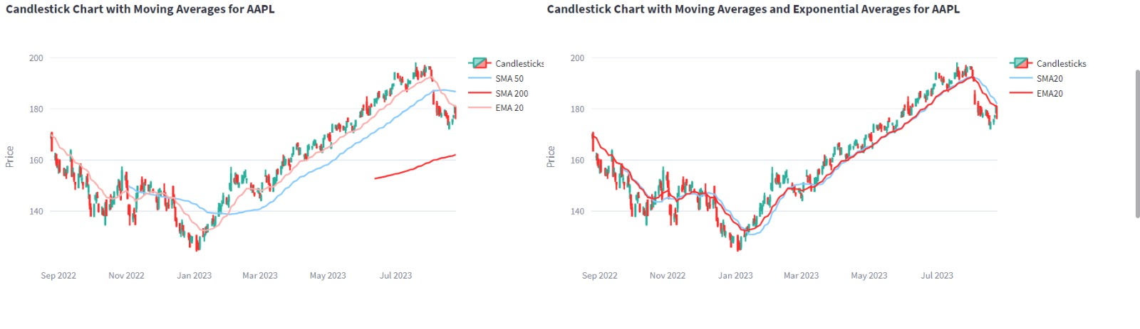
Predict
Dashboard

Slide 16
Through user inputs, they can choose between ascending or descending order, tailoring their insights to their specific needs. These indicators, ranging from Relative Strength Index (RSI) to Moving Averages, are calculated from reliable financial data sources like yahoo finance in a specified period given by an user.
it enables users to quickly access and analyze top-performing metrics within their chosen timeframe, the app promotes confident decision-making in the complex world of finance. It serves as a valuable tool for both brgineers and experienced investors, helping them navigate the markets with greater clarity and insight.
the data is fetched from yahoofinance and interactive charts,patterrns where developed from the plotly, generates user interface by help of python open source library known as streamlit.
7.Indicators :-

Slide 17
8.Bot :-
A chatbot application designed to simulate human conversation through text . It serves as a virtual assistant that can engage in natural language conversations with users, responding to their queries, providing information, and assisting with tasks.
Chatbots use techniques from natural language processing (NLP) to understand and interpret user input, generate appropriate responses, and provide relevant information.
Thus chatbot provides information not only related to stock market it also provides the business, entertainment,scientific related information that helps users to clarify their queries.

Slide 18
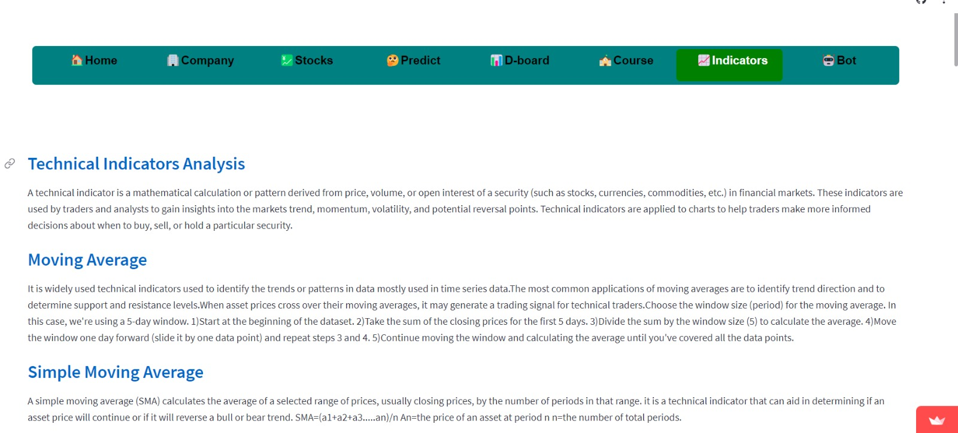
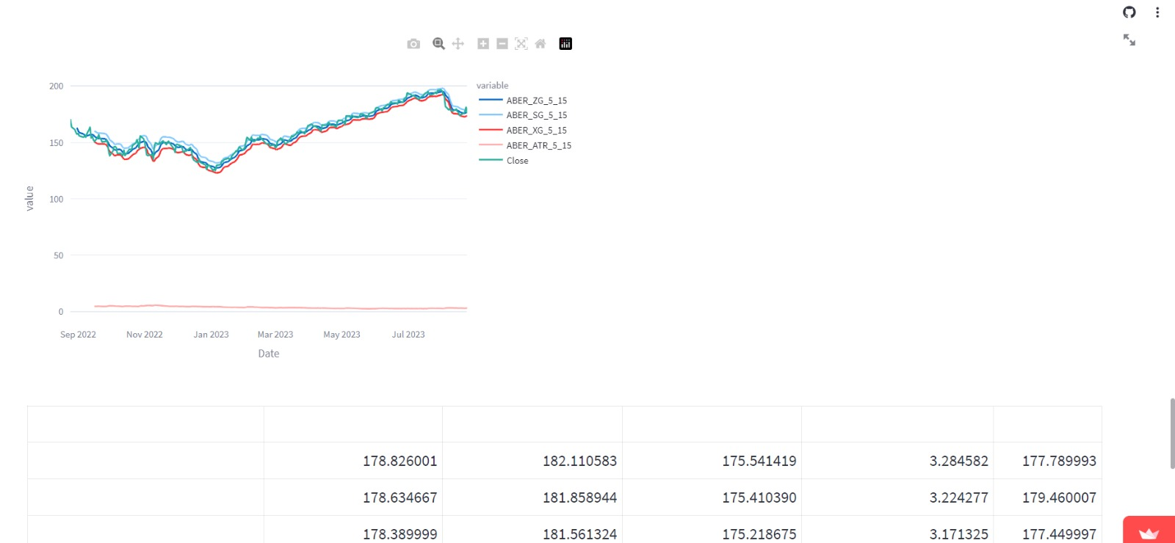
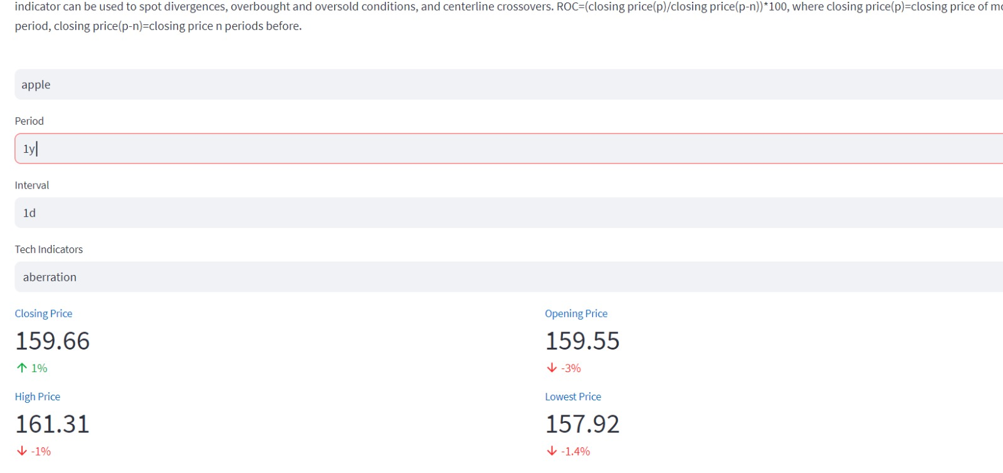
indicators

Slide 19
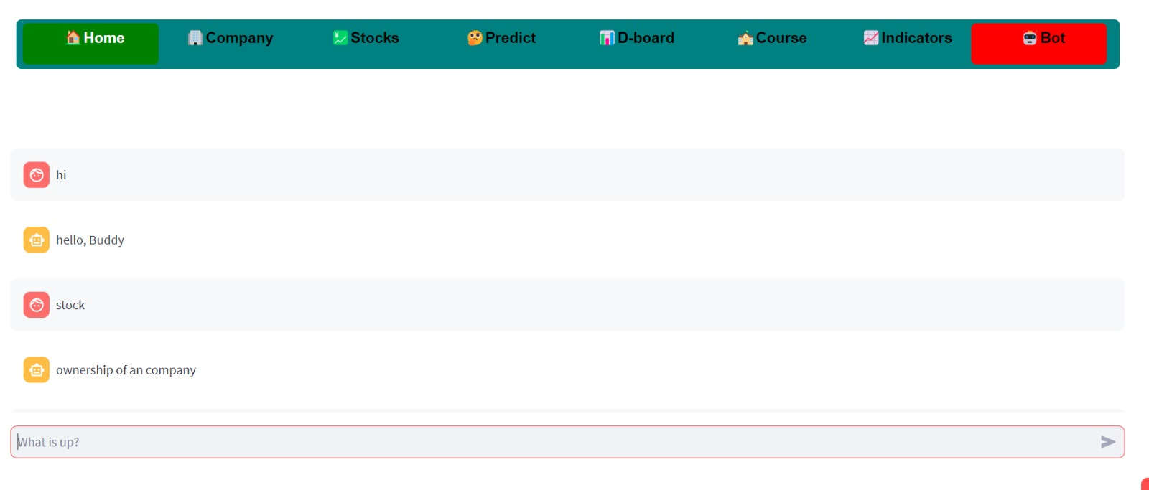
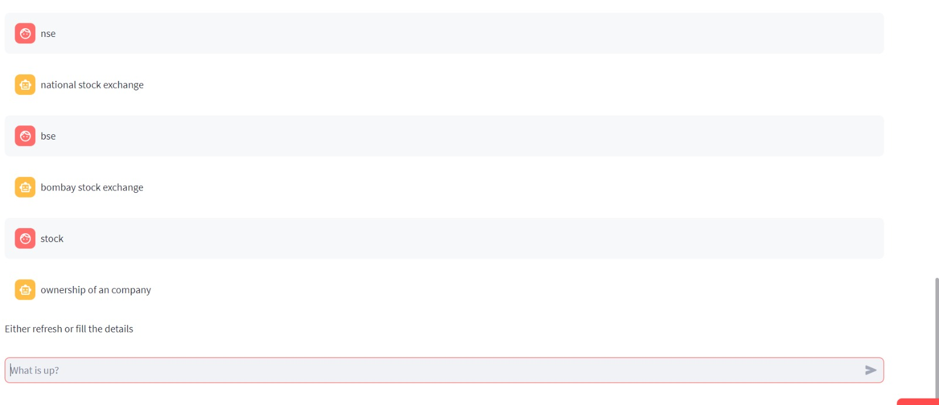
Bot
indicators

Slide 20

Vulnerabilities :
Vulnerability refers to a state of being open to harm, damage, or attack. It can apply to individuals, systems, or entities that have weaknesses or limitations that could potentially be exploited.
Rapid scan is a multitool web vulnerability scanner and it involves multiple scans like nikto , uniscan it not only identifies vulnerabilities It defines them and also provides remedies to prevent them.
It provides upto 80 tests and automated web vulnerability scanner.
Scanning involves large amount of time so user can skip any test involving long time if he supposed to specifies level of vulnerability so which to take action first and which to avoid.
It is absolutely free of cost and contains numerous python Libraries.

Slide 21

Mobile Application :
MIT App Inventor is a visual programming environment that allows individuals, especially those with little to no coding experience, to create mobile apps for Android devices.
login and signup crediantals are been provided in order to secure the data from third party vendors of an data accessed by the user.
Home will be provided after signup and login which gives the whole information about the company and also provides the buttons which on selecting gives the brief information regarding an company.
Chatbot is provided in order to clarity the doubts of an user and news is been given for an daily updates regarding the companies and we can also get the stocks of an company and their changing price movement in order to provide an efficient accesible to an user.

Slide 22

The Conclusion :
From this application user can access historical company data, identify patterns using technical indicators, and offer feedback for website improvements. Comprehensive stock market courses included. Predict future closing prices via recurrent neural networks based on user-specified timeframes, including estimated maximum future prices.
Our chatbot handles user queries comprehensively, while our voice assistant enhances query comprehension for a seamless user experience
this application serves as a knowledge hub for the stock market, enabling users to grasp trends and select predictive algorithms.The app's emphasis on technical indicators equips users to anticipate future performance, fostering confident investing decisions.
The mobile app offers easy access to website features, including historical data, technical pattern recognition, user feedback, and stock market courses. Rigorous security testing ensures vulnerability-free usage.

Slide 23
we have deployed the entire code in an web application and also an android application for the better ease for an user to access the data entire user details are been stored in an database called deta.
Our real-time screener evaluates company performance using dynamic indicators, aiding trading decisions with constantly updated data throughout the trading day.
we also created an interative dashboard using powerbi where this dashboard offers a comprehensive overview of a company's stock performance direction. It facilitates easy comparison between companies using historical data, aiding users in making informed investment or trading decisions.

